Slide 1

Feature Extraction Using Deep Convolutional Neural Networks For Offline Signature Verification
Computer Vision Project
-
-
-
Prof.

Slide 2
Why Signatures?
authorization of individuals are becoming more essential tasks in:
e-commerce
forensic science
engineering
border control
access control
travel and immigration,
Healthcare
…
Traditional authentication methods are less reliable because of loss, forgetfulness, and theft, because they are based on:
knowledge (password-based authentication)
or the utility of a token (photo ID cards, magnetic stripe cards, and key-based authentication)

Slide 3
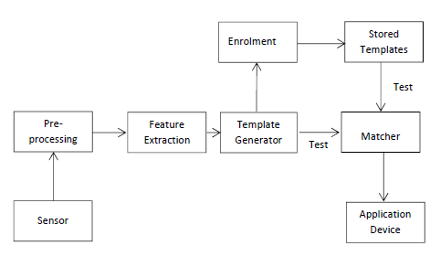
Introduction to Authentication systems
Authentication system is a system that provides:
Process to identify and verify the user's identity
Authenticate users using dynamic features of them
Figure 2. A Generic Authentication System with Computer Vision Technology[3]

Slide 4
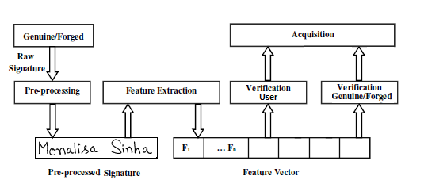
Signature as Images to process
handwritten signatures as it is still one of the most used methods to verify the identity of a person
Our goal is to tackle the problem in the presence of skilled forgeries
We implemented CNN model in Keras to extract some features to distinguish:
two different users' signature
genuine or a forged signature
Figure 3. Block Diagram of our Automatic Signature Verification System

Slide 5
Signature Verification vs. Identification
Signature identification (1: N, one-to-many, recognition):
Must recognize a signature from a list of N signatures in the template database.
Determining a person’s identity by performing matches against multiple templates.
Identification systems are designed to determine identity-based solely on signature information.
Signature Verification (1:1, matching, authentication):
Simply decides whether a given signature belongs to a claimed signature or not.
establishing the validity of a claimed identity by comparing a verification template to an enrollment template.
Needs individuality to be claimed, after which the individual’s enrollment template is located and compared with the verification template.
responses the query, ‘Am I who I claim to be?’ [2]

Slide 6
Types of Forgery Signatures
Three basic types of forged signatures are indicated below:
Random forgery:
The forger is not familiar and has no access to the genuine signature (not even the author’s name) and reproduces a random one.
Simple forgery:
The forger is familiar with the author’s name, but has no access to a sample of the signature.
Skilled forgery:
The forger has access to one or more samples of the genuine signature and is able to reproduce it. But based on the various skilled levels of forgeries, it can also be divided into six different subsets. [2]

Slide 7
Feature learning for Signatures: Related work [1]
A framework for learning the representations directly from the signature images
using Convolutional Neural Networks (CNN).
A novel formulation of the problem
incorporating knowledge of skilled forgeries from a subset of users, using a multi-task learning strategy.
learning visual cues present in the signature images, that are discriminative between genuine signatures and forgeries in general.

Slide 8
main contributions of paper
Formulations to learn features for offline signature verification in a Writer-Independent format.
multi-task framework to jointly optimize the model to discriminate between users, and to discriminate between genuine signatures and skilled forgeries.
A strict experimental protocol, in which all design decisions are made using a validation set composed of a separate set of users.
Generalization performance is estimated in a disjoint set of users, from whom they do not use any forgeries for training.
A visual analysis of the learned representations, which shows that genuine signatures and skilled forgeries get better separated in different parts of the feature space.

Slide 9
Feature learning for Signatures: Related work [1]
Convolutional Neural Networks (CNN)
is a particularly suitable architecture for signature verification.
In CNN architecture used in this work:
The input image goes through a sequence of transformations with
convolutional layers
max-pooling layers
fully-connected layers.
During feature learning, P(y|X) (and also P(f|X) are estimated by performing forward propagation through the model.
The weights are optimized by minimizing one of the defined loss functions

Slide 10
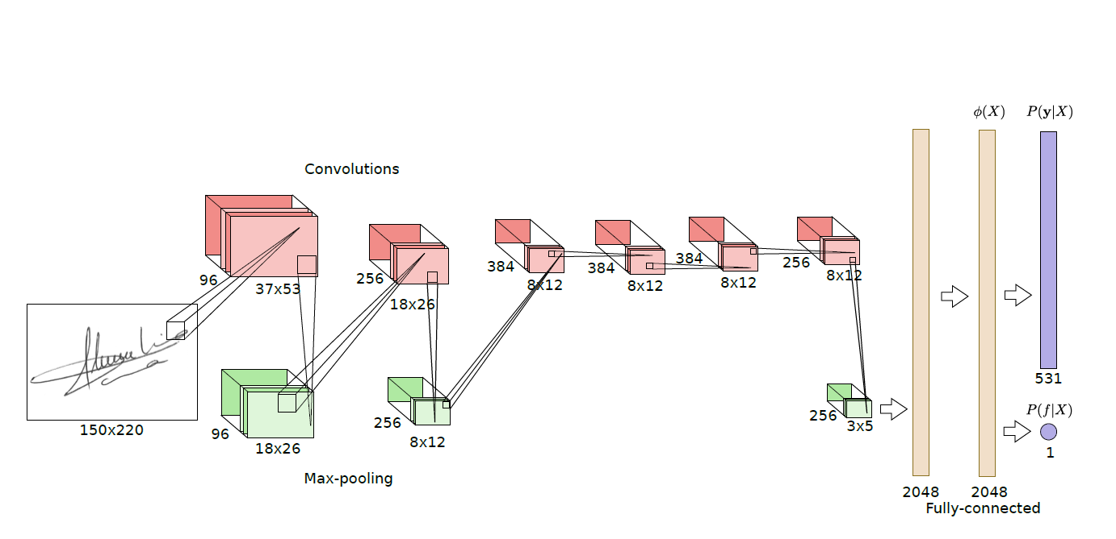
Figure 4. Illustration of the CNN architecture used in original paper.

Slide 11

Multi-task learning framework
Training set composed of tuples (X; y) where X is the signature image, and y is the user.
A neural network with multiple layers, where the objective is to discriminate between the users in the Development set.
The last layer of the neural network has M units with a softmax activation, where M is the number of users in the Development set, and estimates P(y|X).
Figure 4 illustrated one of the architectures used in this work.
Cost function in general.
y_{ij} is the true target for example i, X_{i} is the signature image, and P(y_{j}|X_{i}) is the probability assigned to class j for the input X_{i.}
This cost function can then be minimized with a gradient-based method.

Slide 12
Multi-task learning framework
One of the main goals of a signature verification systems is distinguishing skilled forgeries.
Limitation of the General cost function → nothing in the training process to drive the features to be good in distinguishing skilled forgeries.
Adding a separate output for detecting forgeries and considering two terms in the cost function for feature learning they tackle this issue.
First term drives the model to distinguish between different
Second term drives the model to distinguish between genuine signatures and skilled forgeries.
P(f|X), is another output of the model, a single sigmoid unit, that seeks to predict whether the signature is a forgery or not.

Slide 13
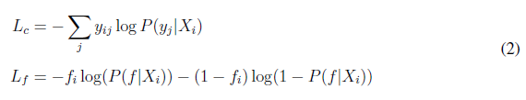
Multi-task learning framework
Training set is tuples of the form (X, y, f)
where X is the signature image
y is the author of the signature (or the target user, if the signature is a forgery)
f is a binary variable that reflects if the sample is a forgery or not (f = 1 indicates a forgery).
Genuine signatures and forgeries targeted to the same user have the same y.
The loss function combines:
user classification loss (L_{c}) is a multi-class cross-entropy,
and the forgery classification (L_{f}) is a binary cross-entropy.

Slide 14
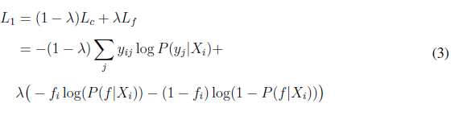
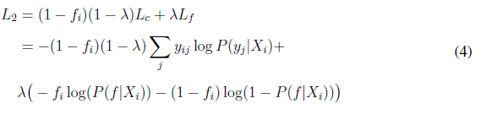
Multi-task learning framework
The first approach for combination considers a weighted sum of both individual losses:
λ is a hyper parameter that trades-off between the two
In a second approach they consider the user classification loss only for genuine signatures the model is not penalized for misclassifying for which user a forgery was made.
First term guides the model to learn features to distinguish between different users.
Second term will focus on characteristics that distinguish between genuine signatures and forgeries.

Slide 15
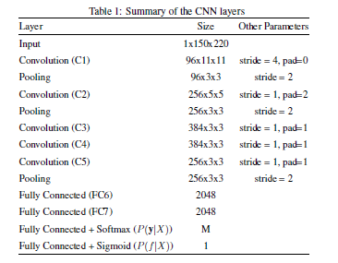
Feature learning systems (1)
The architecture that performed best for the formulation
The CNN consists of multiple layers
Convolutions
Max-pooling
fully-connected layers
Convolutional layers and fully-connected layers have learnable parameters → optimized during training
after each learnable layer they applied Batch Normalization, followed by the ReLU non-linearity.

Slide 16
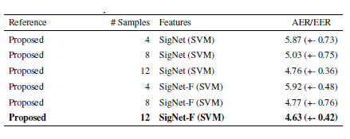
Feature learning systems (2)
Optimization was conducted by minimizing the loss with Stochastic Gradient Descent with:
Nesterov Momentum
Mini-batches of size 32
Momentum factor of 0.9
L2 penalty with weight decay 10e-4, As regularization
60 epochs of training, with an initial learning rate of 10e-3, that was divided by 10 every 20 epochs.
random crops of size 150x220 from the 170x242 signature image.
Table II. SVM classification reported results from paper that is better than state of the art approaches in literature.

Slide 17
Our Implementation
implementing papers method with deep learning architectures like keras and TensorFlow
Feature extraction architecture to extract features
Some modification in their architecture and minimize the number of output features 8 times less than original paper and reach to good result.
In this project, we implement formulations for learning features for Offline Signature Verification from [1]
Evaluate the performance of such features for training Writer-Dependent classifiers.

Slide 18
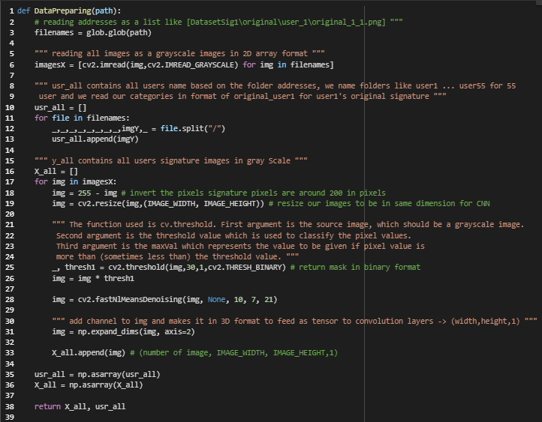
Preprocessing
read all with openCV in python:
images as a grayscale in 2D array format
extract users' name from folder name of image addresses
for all images:
Inverting each image by (image = 255 – image), such that the background is zero-valued.
Resize the image to the input size of the network → (200,320)
Threshold to remove some noises.
Perform cv2.fastNlMeansDenoising function for making signatures without any noises
Convert our Images to 3D format to feed in CNN, we used np.expand_dims() function of NumPy.
At the end we changed all arrays to NumPy array.
Figure 5. Data preparing code in python

Slide 19
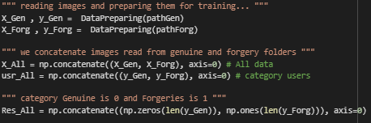
Dataset preparing to train
Our dataset is CEDAR from original paper
CEDAR dataset:
55 user
2640 signature of 55 user
24 genuine and 24 forgery signature for each user
For a multi-output classification network with a single input, we merge the genuine and forgery images together
Separate label vectors for each output:
User label vector → each signature image in one hot encoded format
Res label vector → Result (Genuine=0, forgery=1) in a binary.
Figure 5. Data concatenation code in python

Slide 20
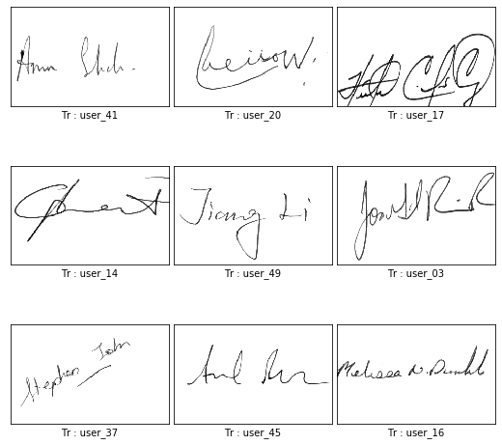
Train Test Split
Training set → 75%
Test Set → 25%
Equal distribution of each users’ signature to train and test
from 24 images →18 for train, 6 for test
Figure 6. Sample images after preprocessing

Slide 21
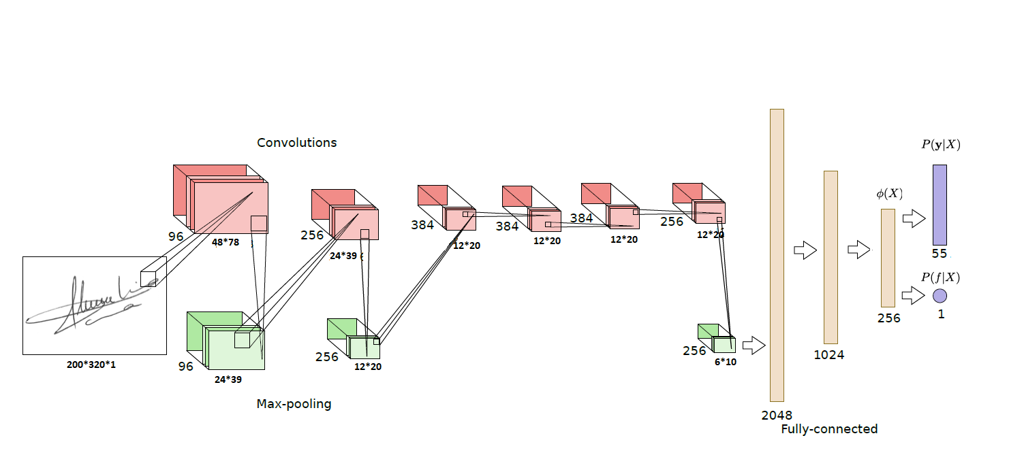
Modified CNN Architecture
Some modifications to minimize the number of output features
2048 size FC layer in paper
Instead of 2 FC layer we used 3 FC layer of size 2048, 1024 and 256,
Speed up the learning process
learnable parameters is half of original model paper model now.
Extracted Features 8x more compact
Figure 7. Our proposed CNN architecture

Slide 22
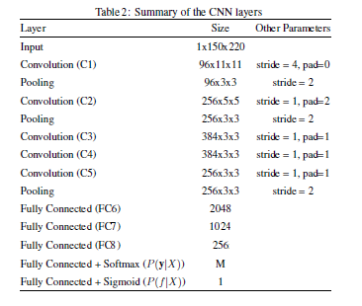
Multi-Output CNN Model Implementation
Deep Convolutional Neural Networks used to extract important features from signature images.
Datasets with M users could used, code is flexible to work with any number of users.

Slide 23
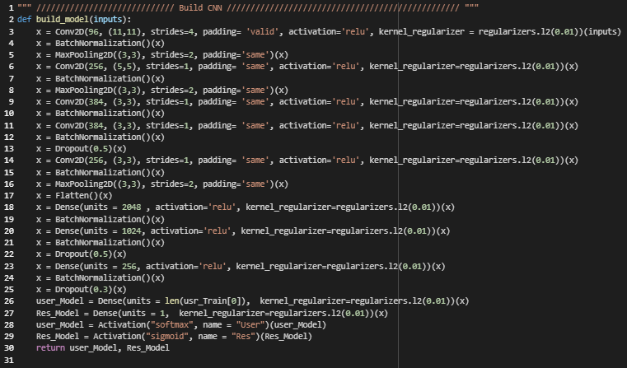
Modified CNN Architecture
CNN model implemented in Keras.
Input image passed to convolutional layer with regularization of 0.01.
After each convolutional layer, batch normalization is applied.
MaxPooling layers used to compress the output features.
DropOut used to Prevent OverFitting
MultiOutput divided to SoftMax and Sigmoid
Figure 8. Python code for our CNN model

Slide 24
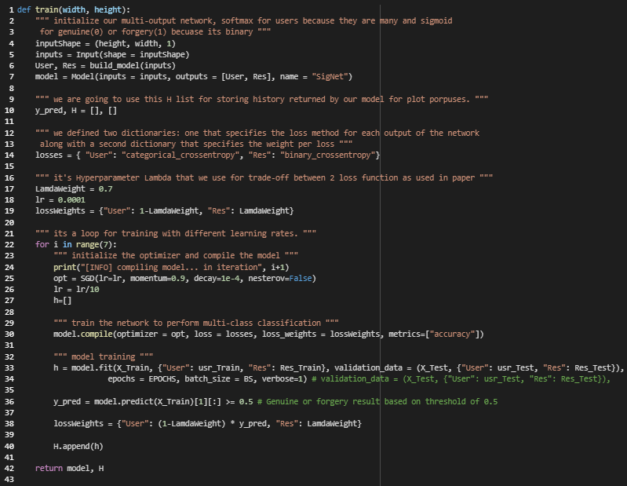
Training our model
Multi-Task architecture:
Output User which contains one node for each enrolled user in the system, it’s used to classify the user given the input signatures.
Output Res is a single node output that only classifies whether the given input signature is a Genuine or a Forgery.
Two different loss function:
categorical_crossentropy → User output layer
binary_crossentropy → Res output layer
Loss weights to both loss functions as mentioned in formula 4 from paper to calculate the loss function, also the paper indicated that best results achieved when they used the lambda weight as 0.9999 but in our case after a lot of tuning best results achieved when we used 0.7.
Stochastic Gradient Descent with Learning rate started from 0.0001 and divided by 10 every 30 epochs.
our batch size was 64, other hyper parameter we used as paper as their results was promising.
Overall, we trained 7*40=280 epochs.
Figure 9. Python code for our model training

Slide 25
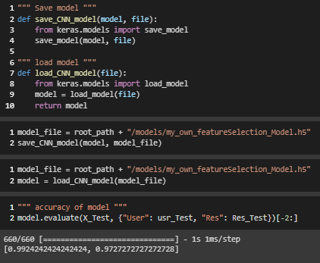
Save, Load and Evaluation of keras model
Model Save and Load
Evaluation of model on our test set of 660 signature
55 users, 6 genuine and 6 forgery image for each user
User accuracy is 99.24
Res accuracy is 97.27 with threshold of 0.5.
Figure 10. Python code for Save and Load Keras model

Slide 26
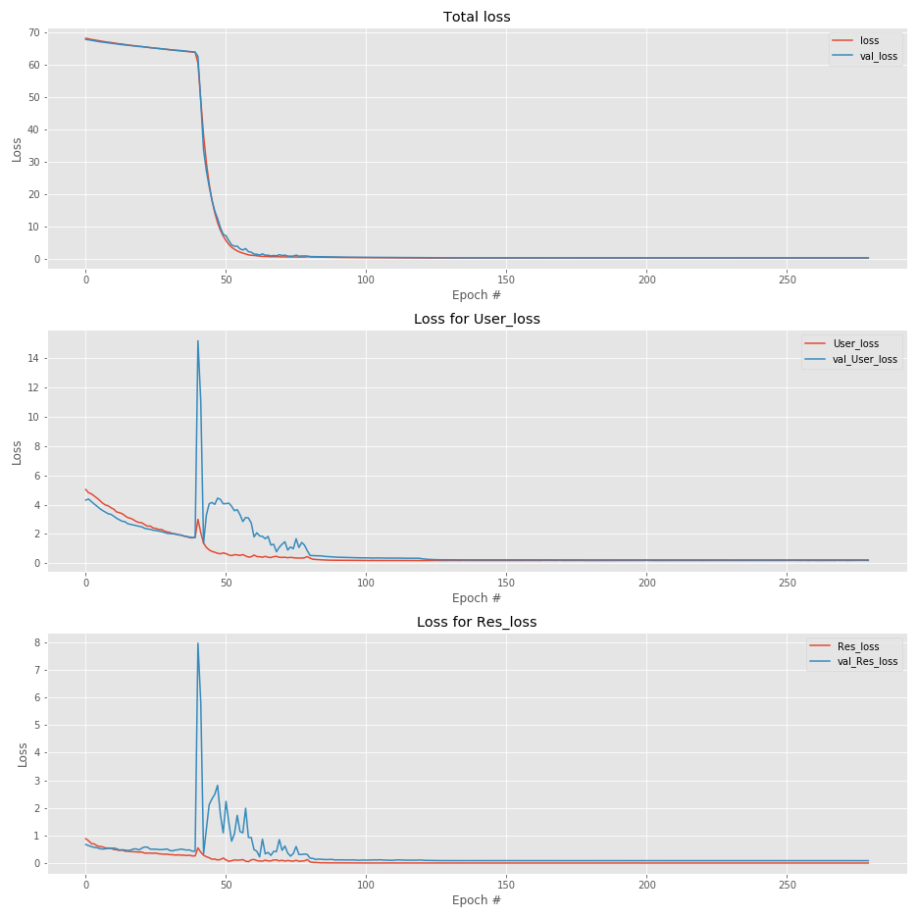
Results from Keras Callback history
Results in all epochs to track the performance and learning of our model
We realize that the fluctuation in accuracy and loss plot in certain epochs like 40 and 80:
Because we are dividing learning rate by 10 in that epochs and model gradient change maybe the direction to learn other characteristics of signatures.
We train model with skipping first 80 epochs, but results was not promising,
We conclude that in first 80 epoch model learns some of characteristics that is necessary for further epochs to learn.
Figure 11. Loss in all epochs for total loss, User loss and Res loss for both train and validation set

Slide 27
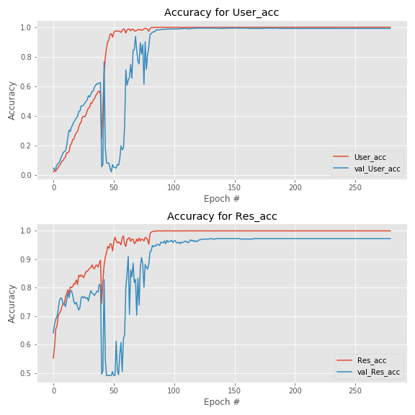
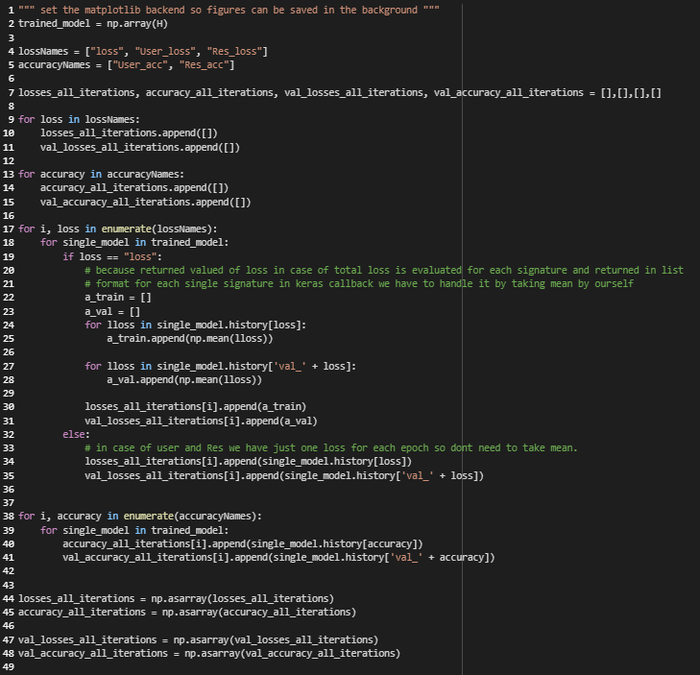
Figure 12. Accuracy in all epochs for User Accuracy and Res Accuracy for both train and validation set
Figure 14. Code for plot accuracy and loss returned by keras model

Slide 28
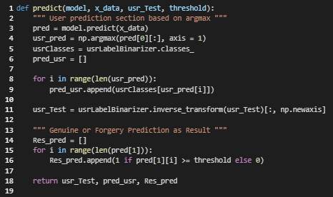
Test and Evaluations
We used argmax to get user’s number from predicted list → convert it to user's name
For getting forgery or genuine we used different thresholds to see which one is better
Figure 15. Code for predict both outputs (User and Res)

Slide 29
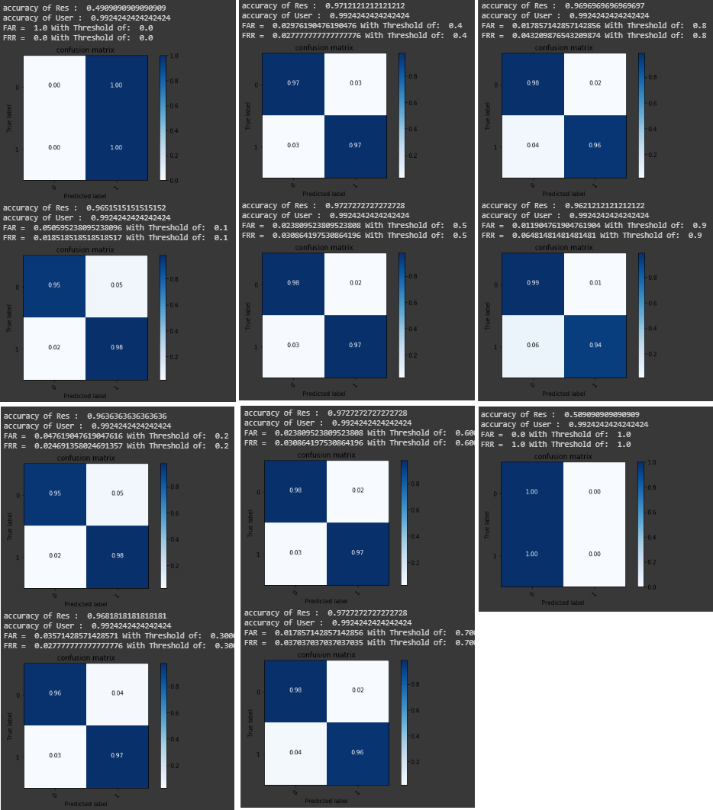
Test and Evaluations
For Res we define a threshold list
[0, 0.1, …,1]
We predict Res for each threshold
Calculate FRR, FAR, accuracy of user and Res
Confusion matrix plotted to have a general view of system to pick the best threshold.
Figure 16. Results plot on test set, accuracies, FAR and FRR based on different thresholds

Slide 30
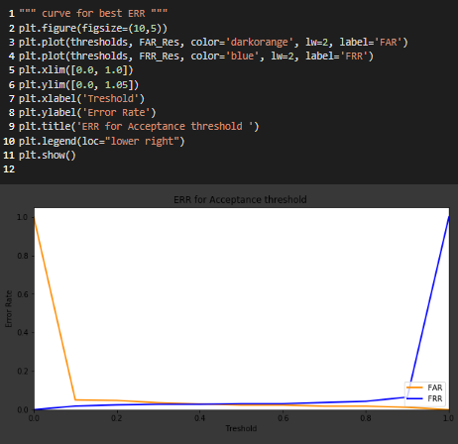
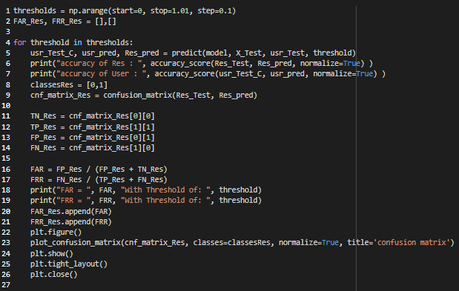
Code for plotting and calculating results
Figure 17. Code for plot confusion matrix and calculating FRR, FAR and accuracies
Figure 18. Code and plot of EER

Slide 31
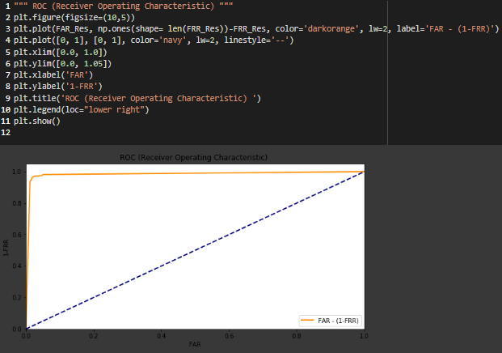
ROC curve
graphical plot that illustrates the diagnostic ability of a binary classifier system as its discrimination threshold is varied.
The ROC curve is created by plotting the TPR against the FPR at various threshold settings. Wikipedia
In plot we can see that as TPR (1-FRR) increase the FAR increase.
Figure 19. ROC curve code and plot

Slide 32
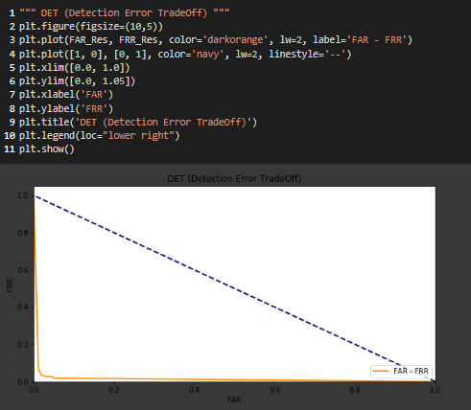
Det curve
graphical plot of error rates for binary classification systems
Plotting the FRR vs FAR.
As the FRR decrease the FAR increase and we must have a balance tradeoff between them.
Figure 20 DET curve code and plot

Slide 33

Results from Keras Callback history
For user we write a code to extract all FA and FR’s for all users
We sum all of user’s to see the number of mistakes of our system out of 660 signatures for test
Just 6 Genuine Rejected users, 0 False Accepted Imposters
We assume all other users' images as imposter for specific user

Slide 34
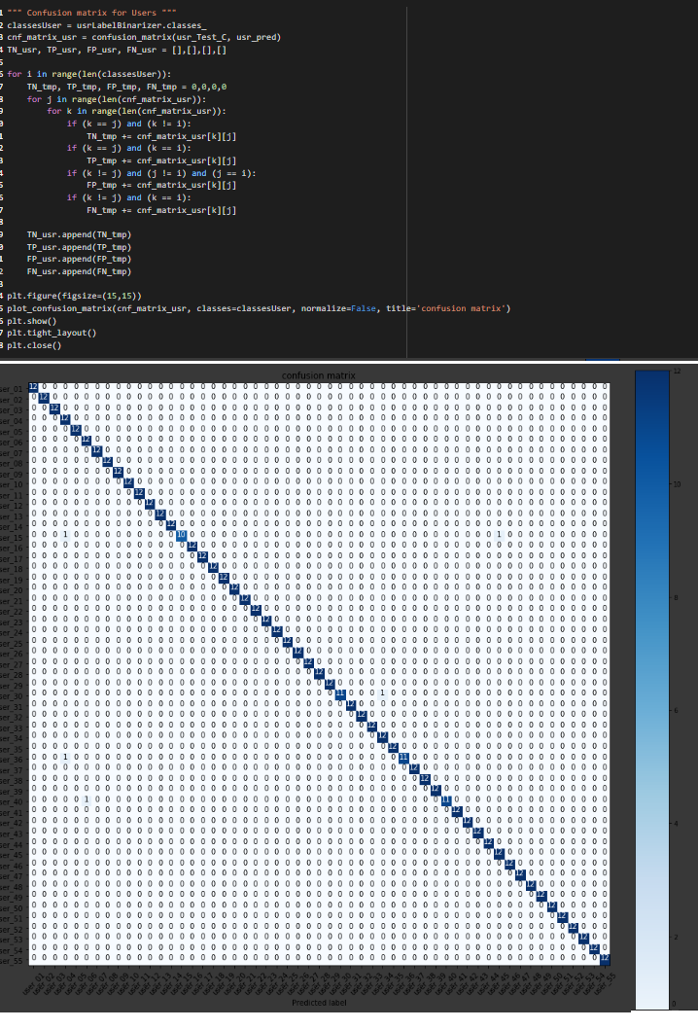
Figure 21. Code for confusion matrix and its plot for users

Slide 35
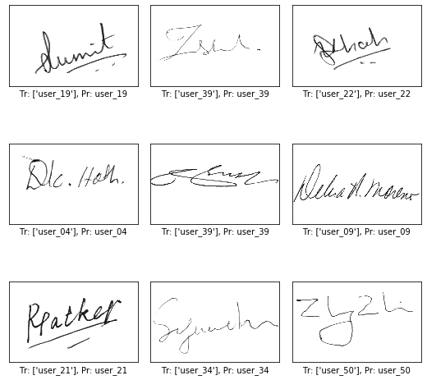
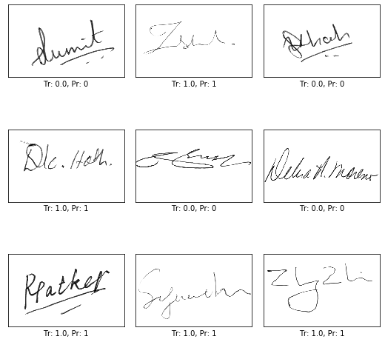
Some of Our systems Predictions
Our predictions for users and their truth
Our predictions for Results and their truth

Slide 36
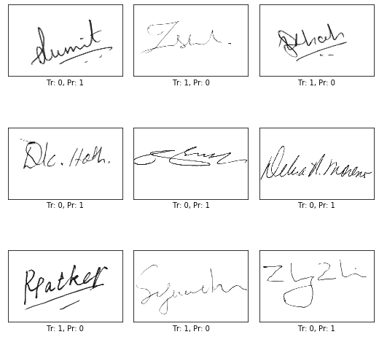
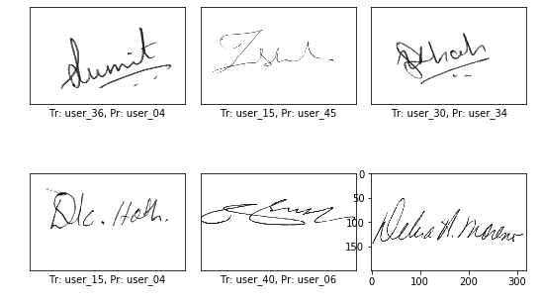
Our systems mistakes
Mistakes for users and their truth
Mistakes for Results and their truth

Slide 37
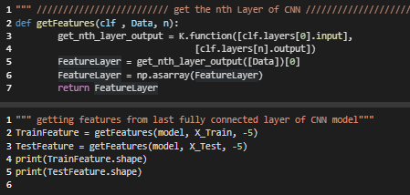
Feature Extraction
Extracting Last FC layer
Use that layer as input features for our RNN architecture networks.
Code to extract features from our Keras model.
Figure 22 Getting Features Python Code

Slide 38
Lstm Model

Slide 39
Bidirectional Lstm Model

Slide 40
Bidirectional GRU Model

